Slide 1
Marketing Requirements Review (MRR) Business Case for: New Canopy Series
Project Cylon
Andrew Stevens | 10/17/19

Slide 2
Agenda
Executive Summary
Total Market Opportunity
Project Overview
Competitive Landscape
Value Proposition
Financial Summary
Risks
Key Project Metrics
Form: QLP5.29B Rev -

Slide 3
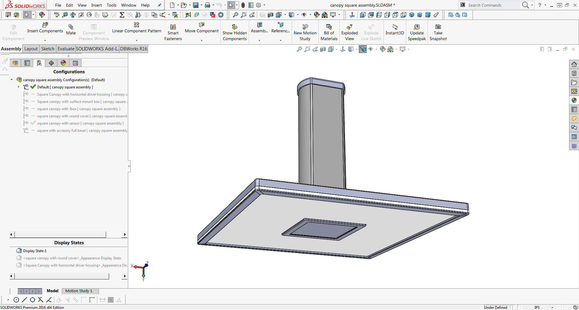
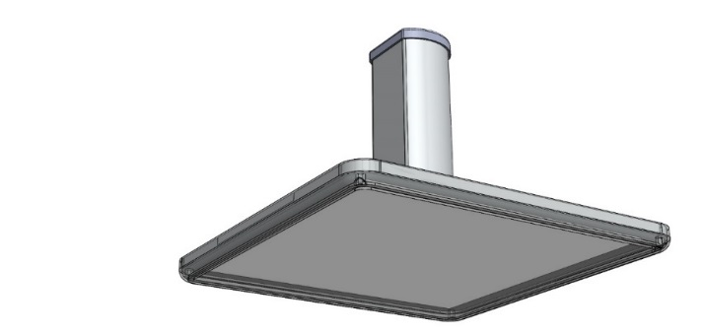

Project Cylon Product Overview
NA | EMEA | APAC | LATAM
Y | Y | ? | Y
Project Description:
Project type: Innovation, New Platform
Deliver a new Canopy platform with updated performance while incorporating game-changing innovation and design
Project Market Drivers:
Target Market: Petroleum, National Accounts, Retail, Banking
Target Application: Petroleum Canopy, Entryways
Sales Channel Focus: Petroleum
Key Product Features:
>150LPW across the line with some higher LPW options
Retrofit solutions for all previous Cree Canopy products
Distributed Power solution to simplify install/maintenance
Large, clean-look optical center
Warranty Period: 10 Years
Project Cost Estimates*
Start-up: $ X
Investment: $ X
ROI: X %
Payback: X.X years
* to be completed for PRR
Financial Estimates | Sales ($M) | SM (%)
Year 1 | $4.3 | 50.0%
Year 2 | $7.4 | 50.0%
Year 3 | $10.5 | 50.0%
KPI | MRR | PRR | DR | QR | PR2 | MLR
GM%
Payback
TTM
Form: QLP5.29B Rev -
Notes:
Changes are to be highlighted from previous presentation

Slide 4
Market Opportunity
Form: QLP5.29B Rev -

Slide 5
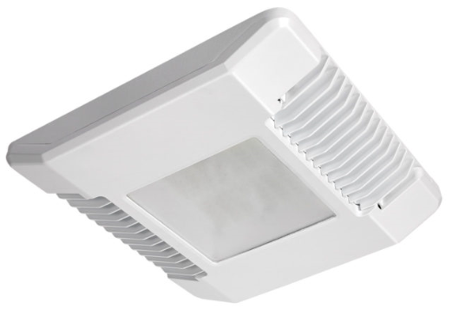
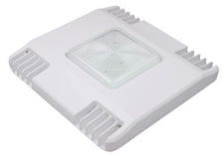
Market Trends
Estimated 3.49% decline in US market opportunity (based on NEMA 2019 revenue data)
Petroleum makes up the majority of the Canopy market and was an early adopter of LED technology
Estimated 70% US Petroleum market conversion to LED already
Our volume is estimated to drop 30-40% if we do nothing
Competitors are offering more efficient products
Increasing number of low-cost players entering the online channel
IP infringement continues

Slide 6
Canopy Market Trends
 | Current | Next 3 Years
Geographic | US primarily Europe | US Europe, MEA (Middle East & Africa) APAC
Competition | LSI Sloan RAB MASI Low cost online/import | LSI Sloan RAB MASI Low cost online/import
Regulatory | DLC 5.0 Title 24 Dark Sky | DLC 6.0 (increase emphasis on light quality) Title 24 Dark Sky (increase expected)
Products | 13,000L package continues to sell best Increasing number of high output options Lots of competition | Emphasis on clean aesthetics, performance, quality Continued increase in low cost options in the market Sensors / Smart?
Channel | Petroleum agents & distributors National accounts & C&I Direct Sales & Online | Petroleum Agents & distributors National Accounts & C&I Direct Sales & Online (expecting increase)
Vertical Markets | Petroleum Retail Banking Hospitality | Petroleum Retail Banking Hospitality
Customers | Petroleum has been a major revenue base for the Canopy market, driven by the major petroleum groups | Maintain/grow major customers Grow small scale customer base through distribution

Slide 7
Parking Structure & Canopy NA Market Segmentation
30.0% overall share
Estimated Data Per NEMA Reporting

Slide 8
Canopy Product Line Strategy
Strategy Overview:
Continued margin and revenue drops caused by increase in competition and diminishing unpenetrated market opportunity
(3.5%) Market opportunity
NPI is necessary to slow our decline in revenue and margin
NPI will help drive to a higher overall Canopy system margin

Slide 9

Canopy Competitive Market Performance Today
 |  | LSI | RAB | Sloan | Online
Breadth
Optionality
Performance
Price
Quality
Service / LT
Channel |  |  |  |  | *
Competitor Actions:
Conducted in-depth initial VOC research to help guide development of a new best-in-class Canopy platform
Project Cylon will enable us to change our Yellow to Green by increased efficiency, easy installation and serviceability, and a competitive yet profitable price point
Cylon will offer new options to the market that are not available today such as remote/linkable drivers
In a market of continuing competition that is getting more and more saturated, we need to deliver a differentiated product that also gives us a higher margin
Notes:
1. Clear to Build is still the most significant opportunity. There are two portions of this that we need to address:
Tactical execution – Clear to Build
Planning – The ability to put in potential orders to see CTB
NEW – 2. Work order demand timing
2. Next priority is the Supplier OTD
3. WMS – I.E. Tugger and PACE changes
OSP
Our ISO 14001:2004 Cert was originally issued June 16, 2016 with no findings.
We had a recertification with no findings last May.
We are upgrading to the ISO 14001:2015 standard and the audit is May 29-June 1. The main changes include larger responsibility for improved environmental performance by our suppliers and contract manufacturers, as well as an improved view on sustainability and the life cycle of our products.

Slide 10
Project Overview
Form: QLP5.29B Rev -

Slide 11
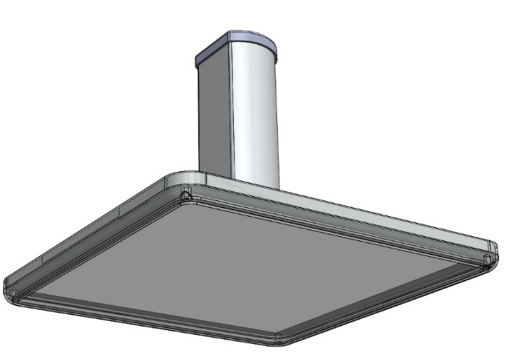
Product Requirements
Concept 1
Concept 2
Will offer a new look for customers who are asking for sleek, clean fixtures
New LEDs: Exploring options outside of Cree
Direct mount and recessed options
New programmable drivers & DALI option
Adapter plates to allow new product to retrofit in any existing Cree Lighting install as well as primary competitors
Full range of outputs, CCT, and CRI mix
2L – 20L, 70/90 CRI, 3000K-5700K
Add link to Product Requirements Spreadsheet
Form: QLP5.29B Rev -

Slide 12
Project Cylon Product Overview
NA | EMEA | APAC | LATAM
Y | Y | ? | Y
Project Description:
Project type: Innovation, New Platform
Deliver a new Canopy platform with updated performance while incorporating game-changing innovation and design
Project Market Drivers:
Target Market: Petroleum, National Accounts, Retail, Banking
Target Application: Petroleum Canopy, Entryways
Sales Channel Focus: Petroleum
Key Product Features:
>150LPW across the line with some higher LPW options
Retrofit solutions for all previous Cree Canopy products
Distributed Power solution to simplify install/maintenance
Large, clean-look optical center
Warranty Period: 10 Years
Project Cost Estimates*
Start-up: $ X
Investment: $ X
ROI: X %
Payback: X.X years
* to be completed for PRR
Financial Estimates | Sales ($M) | SM (%)
Year 1 | $4.3 | 50.0%
Year 2 | $7.4 | 50.0%
Year 3 | $10.5 | 50.0%
KPI | MRR | PRR | DR | QR | PR2 | MLR
GM%
Payback
TTM
Form: QLP5.29B Rev -
Notes:
Changes are to be highlighted from previous presentation

Slide 13
Competitive Landscape

Slide 14
Cree Lighting Canopy SWOT Analysis
Strengths
Weaknesses
Strong market position Brand strength and performance of CPY250 Agent relationships Direct relationships with the major Petroleum companies | Speed to market Adaptability Support of field failures Green-shifted LEDs
Extensive VOC is calling for a fresh new look for the Cree Lighting Canopy family New “best-in-class” product with spec-lock features Building in way to add controls/sensing with value for upsell if the market starts to demand it | Petroleum market is roughly 70% converted to LED already Several main players with strong products Hearing more of Sloan in the market Cheap Chinese products are becoming more common and are improving performance IP infringing knock-offs
Opportunities
Threats
Notes:
1. Clear to Build is still the most significant opportunity. There are two portions of this that we need to address:
Tactical execution – Clear to Build
Planning – The ability to put in potential orders to see CTB
NEW – 2. Work order demand timing
2. Next priority is the Supplier OTD
3. WMS – I.E. Tugger and PACE changes
OSP
Our ISO 14001:2004 Cert was originally issued June 16, 2016 with no findings.
We had a recertification with no findings last May.
We are upgrading to the ISO 14001:2015 standard and the audit is May 29-June 1. The main changes include larger responsibility for improved environmental performance by our suppliers and contract manufacturers, as well as an improved view on sustainability and the life cycle of our products.

Slide 15
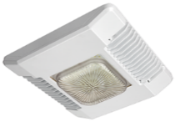

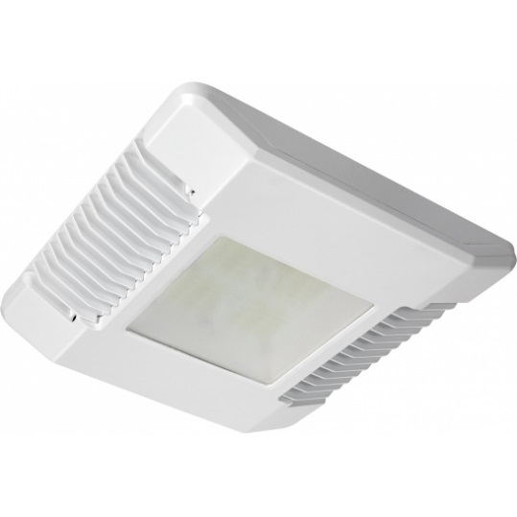
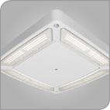
Competitive Product Attributes
Product Family | CPY250 | Vertex
Efficacy | 4,400 – 19,600 Lumens 31-145 Watts 13L = 129LPW 13L = 146LPW H.E. | 10218 – 22652 Lumens 66 – 153 Watts 150 LPW
Optics | Symmetric Flat lens, drop lens Sparkle | Symmetric Combo Forward Silicone lens
Optionality | 0-10V dim, PML 90 CRI | 0-10V standard Motion sensor Synapse 90CRI
Installation | Direct Pendant Hook & Cord | Direct Pendant
Field Serviceability | From below | From below
IP Rating | IP66 (DM mount & H&C) | IP66 optics IP54 housing
Identified for teardown
Teardown complete
Notes:
1. Clear to Build is still the most significant opportunity. There are two portions of this that we need to address:
Tactical execution – Clear to Build
Planning – The ability to put in potential orders to see CTB
NEW – 2. Work order demand timing
2. Next priority is the Supplier OTD
3. WMS – I.E. Tugger and PACE changes
OSP
Our ISO 14001:2004 Cert was originally issued June 16, 2016 with no findings.
We had a recertification with no findings last May.
We are upgrading to the ISO 14001:2015 standard and the audit is May 29-June 1. The main changes include larger responsibility for improved environmental performance by our suppliers and contract manufacturers, as well as an improved view on sustainability and the life cycle of our products.

Slide 16
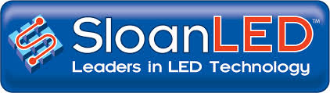
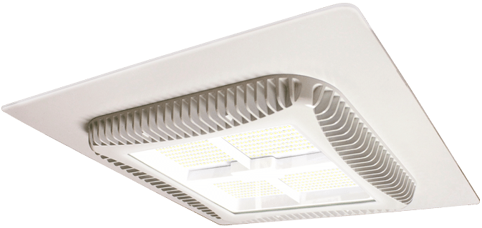
Competitive Product Attributes
Product Family | CPY250
Efficacy | 4,400 – 19,600 Lumens 31-145 Watts 13L = 129LPW 13L = 146LPW H.E. | 5,000 - 23,100 Lumens 36 – 164 watts 125 LPW – 13L
Optics | Symmetric Flat lens, drop lens Sparkle | Symmetric Flat lens
Optionality | 0-10V dim, PML 90 CRI | 0-10V dim
Installation | Direct Pendant Hook & Cord | Direct
Field Serviceability | From below | Driver above canopy
IP Rating | IP66 (DM mount & H&C) | IP68
Identified for teardown
Notes:
1. Clear to Build is still the most significant opportunity. There are two portions of this that we need to address:
Tactical execution – Clear to Build
Planning – The ability to put in potential orders to see CTB
NEW – 2. Work order demand timing
2. Next priority is the Supplier OTD
3. WMS – I.E. Tugger and PACE changes
OSP
Our ISO 14001:2004 Cert was originally issued June 16, 2016 with no findings.
We had a recertification with no findings last May.
We are upgrading to the ISO 14001:2015 standard and the audit is May 29-June 1. The main changes include larger responsibility for improved environmental performance by our suppliers and contract manufacturers, as well as an improved view on sustainability and the life cycle of our products.

Slide 17
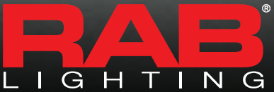
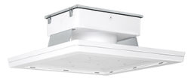
Competitive Product Attributes
Product Family | CPY250 | MASI
Efficacy | 4,400 – 19,600 Lumens 31-145 Watts 13L = 129LPW 13L = 146LPW H.E. | 6,800 - 29,000 Lumens 55 – 212 watts 125 – 144 LPW
Optics | Symmetric Flat lens, drop lens Sparkle | Symmetric Flat lens
Optionality | 0-10V dim, PML 90 CRI | 0-10V dim
Installation | Direct Pendant Hook & Cord | Direct
Field Serviceability | From below | Driver above
IP Rating | IP66 (DM mount & H&C) | IP66
Notes:
1. Clear to Build is still the most significant opportunity. There are two portions of this that we need to address:
Tactical execution – Clear to Build
Planning – The ability to put in potential orders to see CTB
NEW – 2. Work order demand timing
2. Next priority is the Supplier OTD
3. WMS – I.E. Tugger and PACE changes
OSP
Our ISO 14001:2004 Cert was originally issued June 16, 2016 with no findings.
We had a recertification with no findings last May.
We are upgrading to the ISO 14001:2015 standard and the audit is May 29-June 1. The main changes include larger responsibility for improved environmental performance by our suppliers and contract manufacturers, as well as an improved view on sustainability and the life cycle of our products.

Slide 18
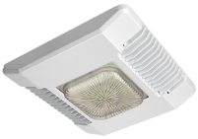
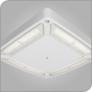
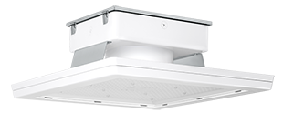
Competitive Landscape - CPY250
Identified for tear-down
Product Name | Cree CPY250 | LSI Vertex (SCV) | Sloan PDL3 Modus | RAB MASI
Product Photo
Specification Experience
Family Members | A, B*, C, E, F* | 10L, 13L, 15L, 20L, 23L | 75W, 150W, 200W | 52W, 80W, 100W, 160W, 200W
MH Equivalency (up to) | 150W, 320W*, 100W, 400W | 250W, 320W, 400W | 400W | 150W, 200W, 250W, 320W, 400W
Photometric
Optics | Symmetric | Symmetric, Combo Forward | Symmetric | Symmetric
CCTs | 30K, 40K, 57K | 40K, 50K | 40K, 50K | 30K, 40K, 50K
CRIs | 70 | 70 | 70 | 70
Lumens (4000K) | 7600, 12380, 4420, 19600, 12380 | 10218, 12793, 15209, 20083, 22652 | 5000, 7000, 9000, 11700, 13100, 15200, 18100, 10400, 23100 | 6857, 12192, 15454, 23017, 29172
Wattage (4000K) | 60, 96, 31, 145, 85 | 66, 84, 103, 130, 153 | 36, 51, 66, 88, 105, 125, 123, 141, 164 | 55, 85, 115, 160, 212
LPW (4000K) | 127, 129, 143, 135, 146 | 156, 153, 150, 153, 149 | 125 (13100L/105W) | 125, 143, 135, 144, 138
L90 LMF (25C) | 75k hours | >50k hours | 60k-100k hours L70 | Not listed
Mechanical
Ambient Temp (Metal) | 40C to -40C | 40C to -40C | 40C-60C to -40C | 40C to -40C
Lens Material | Glass, drop and flat | Silicone, flat | Glass, flat | Glass, flat
Weight | 12 lbs. | 15 lbs. (shipping weight) | Not listed | 26 lbs, 33 lbs.
Certifications | UL, RoHS, Hazloc, NSF | UL, RoHS, Hazloc | UL, RoHS, T24, Explosion | UL, RoHS
Installation Experience
Mounting Options | Direct, Pendant, H&C | Direct, Pendant | Direct | Direct
IP Rating | IP66 (DM mount) | IP66 optics, IP54 housing | IP68 | IP66
Controls Integration | 0-10V dim, PML | 0-10V standard, motion sensor, Synapse | 0-10V dim | 0-10V dimming
Retrofit kits | Various HID, Cree 304 | LSI HID, Cree 228, Surface mount kit | Shoebox plate | Custom
Ownership Experience
Service Access | From below | From below | Above the deck | Not listed
Warranty | 10 years | 5 years, 10 year option | 10 years | 5 years incl. color shift
DLC Qualification | Premium/Standard | Premium/Standard | Premium | Premium
Surge Protection | 6 kV | 6 kV | Not listed | Not listed
Shield Accessory | None | None | None | No
Form: QLP5.29B Rev -

Slide 19
Value Proposition
Form: QLP5.29B Rev -

Slide 20
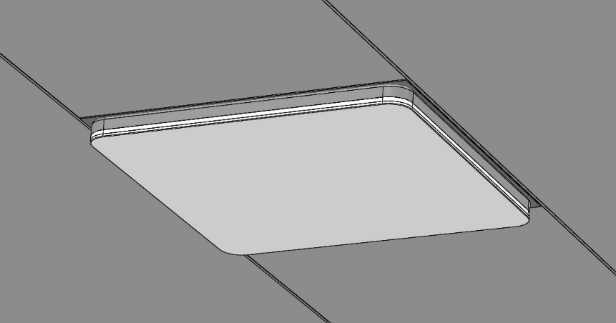
Value Proposition
Project Cylon will reaffirm Cree Lighting as an innovative market leader in the Canopy market with a focus on Petroleum. The design will meet a very broad range of customer requirements in various Canopy & Soffit applications. Innovative installation & maintenance methods along with tunable options will add value to customers and help lock our product in on many large Petroleum customer specs. This product will enable us to better answer current and future market pressures while improving our margin.
Form: QLP5.29B Rev -

Slide 21
Financial Summary
Form: QLP5.29B Rev -

Slide 22
Annual Volume Projections
Volume Projection Support
Market size & projections
Current Cree product volume trend & share
Added value/options that support increases
Increased market share (why)
Cannibalization effects
Form: QLP5.29B Rev -

Slide 23
Cannibalization
Cannibalization of CPY250
CPY has a 42-43% SM projection
Cylon has a 50% SM target
Will allow us to sunset 228, 304 whereby streamlining needs
Form: QLP5.29B Rev -

Slide 24
Financial Summary
Insert link to QLP5.29C
Assumes
50% SM target
Hits $190 price point for 13L
Petroleum market requirement
Form: QLP5.29B Rev -

Slide 25
Business Unit Risk Assessment
Form: QLP5.29B Rev -

Slide 26
Cylon Project Impact - Do Nothing vs Do
Form: QLP5.29B Rev -

Slide 27
Key Project Metrics
Form: QLP5.29B Rev -

Slide 28
Key Project Metrics
Minimum 150 LPW in 13,000 lumen 5700K for PDP ASP $185
Deliver to market (Orderable) at NACS/PEI 2020 (October 11-14)
Keep “Sparkle” option available
50% SM
Form: QLP5.29B Rev -

Slide 29
Key Configurations Minimum Available at Launch
Deliver to market (Orderable) at NACS/PEI (October 11-14, 2020)
150+ LPW in 13,000 lumen 5700K
3000K & 5700K 70CRI
CY-A-DM-D-13L-xxK7-UL-WH-HZ = $190 (direct mount, drop lens/”sparkle”)
CY-A-DM-F-13L-xxK7-UL-WH-HZ = $180 (direct mount, flat lens)
CY-A-RC-D-13L-xxK7-UL-WH-HZ = $190 (recessed canopy, drop lens/”sparkle”)
CY-A-RC-F-13L-xxK7-UL-WH-HZ = $180 (recessed canopy, flat lens)
50% SM
Form: QLP5.29B Rev -

Slide 30
Schedule Targets
Requested Timing Alignment
MRR Approval: October 17, 2019
PRR Approval: November 2019
DR Approval:
DCR Approval:
PR2 Approval: Aug/Sept 2020
CLR Approval: October 2020
*Schedule open to discussion, but must consider minimum launch details on previous slide with clear plan to complete full offering
Form: QLP5.29B Rev -

Slide 31
Project Cylon Product Overview
NA | EMEA | APAC | LATAM
Y | Y | ? | Y
Project Description:
Project type: Innovation, New Platform
Deliver a new Canopy platform with updated performance while incorporating game-changing innovation and design
Project Market Drivers:
Target Market: Petroleum, National Accounts, Retail, Banking
Target Application: Petroleum Canopy, Entryways
Sales Channel Focus: Petroleum
Key Product Features:
>150LPW across the line with some higher LPW options
Retrofit solutions for all previous Cree Canopy products
Distributed Power solution to simplify install/maintenance
Large, clean-look optical center
Warranty Period: 10 Years
Project Cost Estimates*
Start-up: $ X
Investment: $ X
ROI: X %
Payback: X.X years
* to be completed for PRR
Financial Estimates | Sales ($M) | SM (%)
Year 1 | $4.3 | 50.0%
Year 2 | $7.4 | 50.0%
Year 3 | $10.5 | 50.0%
KPI | MRR | PRR | DR | QR | PR2 | MLR
GM%
Payback
TTM
Form: QLP5.29B Rev -
Notes:
Changes are to be highlighted from previous presentation

